Slide 1
Introduction to Database
Concept and Tools

Slide 2
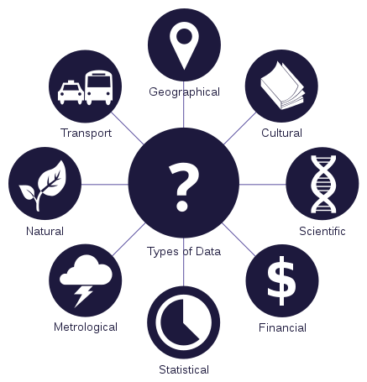
Data
A single piece of information, as a fact, statistic, or code; an item of data.
Data can be a picture, file, video, PDFs etc

Slide 3
What is a Database?
Systematic collection of data
Significance of a database
  To store data
  To provide an organizational structure for data
  To provide a mechanism for querying, creating, updating and deleting

Slide 4
Why use a Database?
Size
Ease of updating
Accuracy
Security
Redundancy

Slide 5

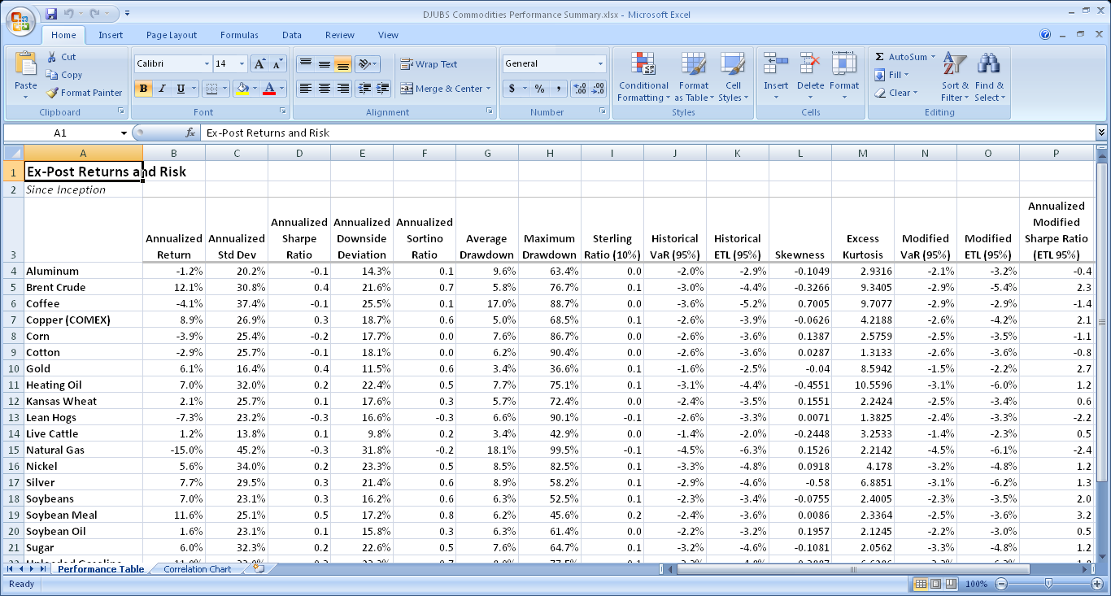

Slide 6
Database Management System (DBMS)
A collection of programs; software
Used to access a database, manipulate data, & representation of data
Control User access levels to the database
Example: An online telephone directory

Slide 7
SQL Database
Stands for Structured Query Language
ANSI Standard language for communicating with an RDMBS
Not a programming language
Eg: Oracle, MySQL, Microsoft SQL Server
SQL is composed of
  Data Definition Language (DDL)
    Used to define and manage database structures
  Data Manipulation Language (DML)
    Used to create and update data in a database
  Data Control Language (DCL)
    Used to create user accounts, access controls etc

Slide 8
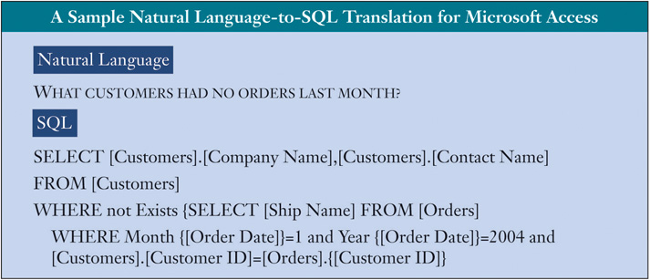

Slide 9
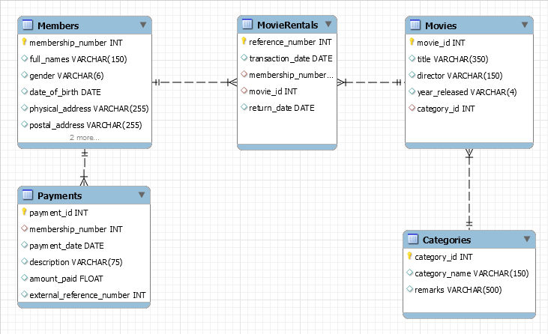
ER Modeling

Slide 10
Advantages of RDMBS
Better for relational data
Normalization
Well known language with a large community
Data integrity using constraints
    Primary Key
    Foreign Key
    Not Null
    Unique
    Check

Slide 11

SQL DEMO
Install Xamp
Start Xamp server
Browse http://localhost/phpmyadmin

Slide 12
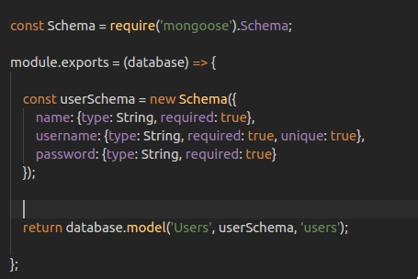
NoSQL Databases
Stands for Not only SQL
A non-relational database, I.e No tables
A flexible database used for big data and real-time web apps
Schema less design. However, schema can be maintained using ODM.

Slide 13
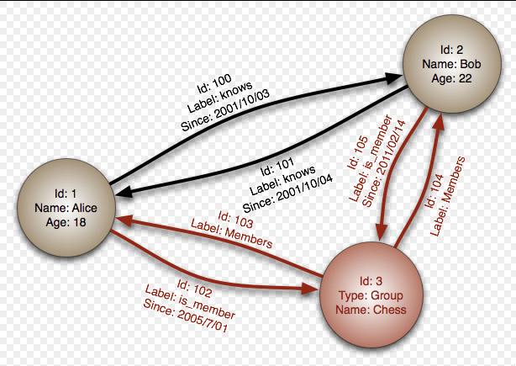
Types of NoSQL Databases
Key/Value pairs [Firebase]
Document oriented database [MongoDB]
Graph Database[Facebook Graph Search]
Fig: Graph Database

Slide 14
Big Data
A term of data sets that are so huge that traditional methods of storage and processing are inadequate
Data in the Petabyte range
Massive increase in data volume within the last decade
Social network, search engines etc.
Challenges in storage, capture, analysis, transfer etc.

Slide 15


NoSQL Demo
Install MongoDB
Install Robo3t GUI for MongoDB
Start Robo3t

Slide 16
Advantages of NoSQL
Handles Big Data
Data structure – NoSQL handles unstructured data. However, schema can be created on the application layer
Scaling out or Horizontal scaling, i.e. using more servers for load balancing.
Denormalization

Slide 17
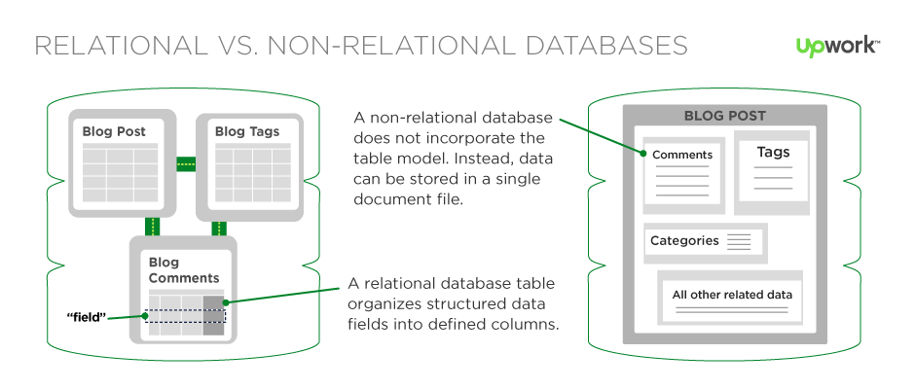
SQL V/s NoSQL
Relational v/s Non-Relational
Table based v/s Key-Value pair, documents, graph
Predefined constraints v/s no such schema
Vertical v/s Horizontal scaling
Complex v/s Weak query
Notes:
Relational | non-relational
Table based | k/V, document, graph
Constraint | no schema but mongoose
Vertically scaled | horizontally scaled
Complex query | weak queries

Slide 18
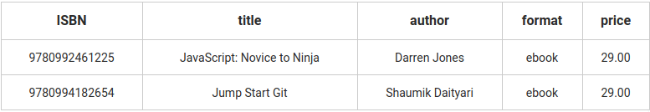
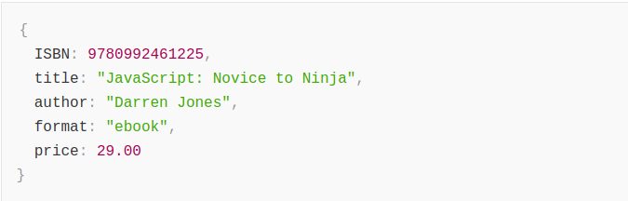
SQL Data structure
NoSQL Data Structure

Slide 19


